Slide 1
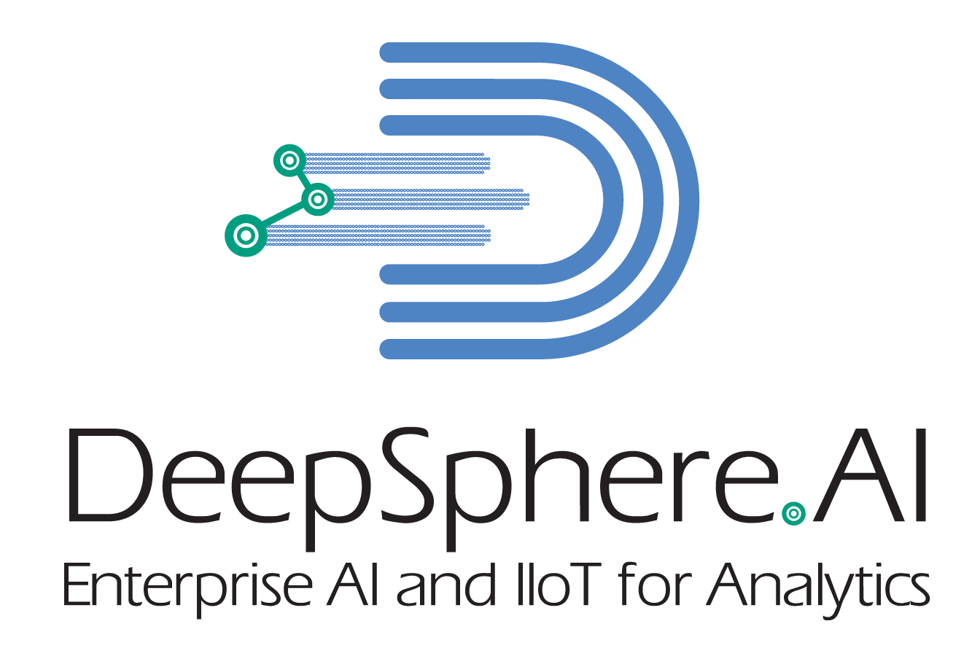
Basic Predictive Analytics
USA | Singapore
©DeepSphereAI.SG 2021 | Confidential & Proprietary

Slide 2
Popular machine learning frameworks
TensorFlow
PyTorch
scikit-learn (sklearn)
Spark ML
Torch
Huggingface
Keras
USA | Singapore
©DeepSphereAI.SG 2021 | Confidential & Proprietary

Slide 3
Scikit
Scikit is another Python package that can perform many useful machine-learning tasks:
Linear regression
Decision tree regressions
Random Forest regressions
K-Nearest neighbor
SVMs
Stochastic Gradient Descent models
And more
Scikit Benefits
Scikit provides model analysis tools like the confusion matrix for assessing how well a model performed.
Many times, you can start an ML job in scikit-learn and then move to another framework. For example, scikit-learn has excellent data pre-processing tools for one-hot encoding categorical data.
USA | Singapore
©DeepSphereAI.SG 2021 | Confidential & Proprietary

Slide 4
Choosing your ML too
Image data
Language data (text data)
Voice data
Video data
Large amounts of numbered and categorical data
The complexity of the problem
Data type
Data volume
Resource availability (computing, data processing, community support, etc.)
USA | Singapore
©DeepSphereAI.SG 2021 | Confidential & Proprietary

Slide 5
What’s an ML framework?
Machine learning relies on algorithms. Unless you’re a data scientist or ML expert, these algorithms are very complicated to understand and work with.
A machine learning framework, then, simplifies machine learning algorithms. An ML framework is any tool, interface, or library that lets you develop ML models easily, without understanding the underlying algorithms.
USA | Singapore
©DeepSphereAI.SG 2021 | Confidential & Proprietary

Slide 6
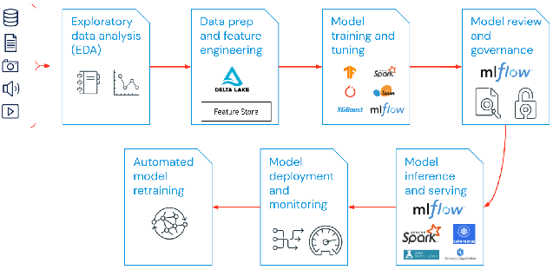
Why do we need MLOps?
Machine learning operations (MLOps)
MLOps is a useful approach for the creation and quality of machine learning and AI solutions. By adopting an MLOps approach, data scientists and machine learning engineers can collaborate and increase the pace of model development and production, by implementing continuous integration and deployment (CI/CD) practices with proper monitoring, validation, and governance of ML models.
USA | Singapore
©DeepSphereAI.SG 2021 | Confidential & Proprietary

Slide 7
What are the components of MLOps?
A majority of enterprises deploy MLOps principles across the following:
Exploratory data analysis (EDA)
Data Prep and Feature Engineering
Model training and tuning
Model review and governance
Model inference and serving
Model Monitoring
Automated model retraining
USA | Singapore
©DeepSphereAI.SG 2021 | Confidential & Proprietary

Slide 8
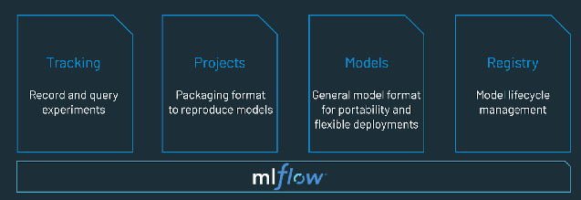
What is an MLOps platform?
An MLOps platform provides data scientists and software engineers with a collaborative environment that facilitates iterative data exploration, real-time co-working capabilities for experiment tracking, feature engineering, and model management, and controlled model transitioning, deployment, and monitoring. It also automates the operational and synchronization aspects of the machine learning lifecycle.
USA | Singapore
©DeepSphereAI.SG 2021 | Confidential & Proprietary

Slide 9
Cross Validation - Evaluating Model Performance
Regular Fitting
Model meets expected outcome (ex: Predicted model outcome meets desired outcome)
The model outcome in grade prediction is "A," and the expected outcome is also "A."
Under Fitting
The model failed to meet the expected outcome (ex., the predicted model was lower than desired).
The model outcome in grade prediction is "B+," and the expected outcome is also "A."
Over Fitting
The model failed to meet the expected outcome (ex., the predicted model outcome was higher than desired).
The model outcome in grade prediction is “A+," and the expected outcome is also "A."
USA | Singapore
©DeepSphereAI.SG 2021 | Confidential & Proprietary

Slide 10
Cross Validation - Evaluating Model Performance

Slide 11
Cross Validation - Evaluating Model Performance
Option #1
For training and testing, we use the same data set
Option #2
For training and testing, split the data set into 70/30, 80/20, or 90/10
Option #3
Cross Validation
K Fold
Stratified K-Fold
Leave-One-Out (LOO)
Leave-P-Out (LPO)
Shuffle Split (Monte Carlo cross-validation)
USA | Singapore
©DeepSphereAI.SG 2021 | Confidential & Proprietary

Slide 12
Cross Validation - Evaluating Model Performance
Data Set
1000 Records
Training Data Set
Test Data Set
700 Records
300 Records
Training Data Set
Test Data Set
700 Records
300 Records
Validation Set
The training, tuning, and evaluation process
Learning
Algorithm
The training, tuning, and evaluation process
Model Outcome
USA | Singapore
©DeepSphereAI.SG 2021 | Confidential & Proprietary

Slide 13
Cross Validation - K Fold
The model is trained and tested using data from the entire dataset
Data Set
(for Training and Testing the Model)
Fold 1
Test
Train
Train
Train
Train
Fold 1
Train
Test
Train
Train
Train
Fold 3
Train
Train
Test
Train
Train
Fold 4
Train
Train
Train
Test
Train
Fold 5
Train
Train
Train
Train
Test
Model score
Model score
Model score
Model score
Model score
Average
USA | Singapore
©DeepSphereAI.SG 2021 | Confidential & Proprietary

Slide 14
Cross Validation - K Fold and Stratified K-Fold
The model is trained and tested using data from the entire dataset.
Height | Weight | Color | Ethnicity
4 | 50 | White | Chinese
5 | 75 | Brown | Indian
5.5 | 100 | White | American
6 | 125 | Black | African
In General
K Folds does not distribute classes evenly across its folders
Overfitting
Stratified K-Fold
Stratified K-Fold distributes classes evenly across its folders
No Overfitting
USA | Singapore
©DeepSphereAI.SG 2021 | Confidential & Proprietary

Slide 15
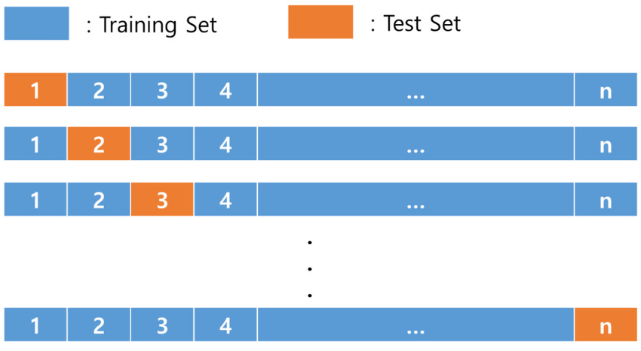
Cross Validation - leave-one-out cross-validation (LOOCV)
It is very time-consuming to train the model.
One Record for testing each iteration
Imagine you have 100 records. The model is tested on the first record during the first iteration, and the remaining 99 records are trained.
Imagine you have 100 records. The model is tested on the second record during 2 iterations, and the remaining 99 records are trained.
USA | Singapore
©DeepSphereAI.SG 2021 | Confidential & Proprietary

Slide 16
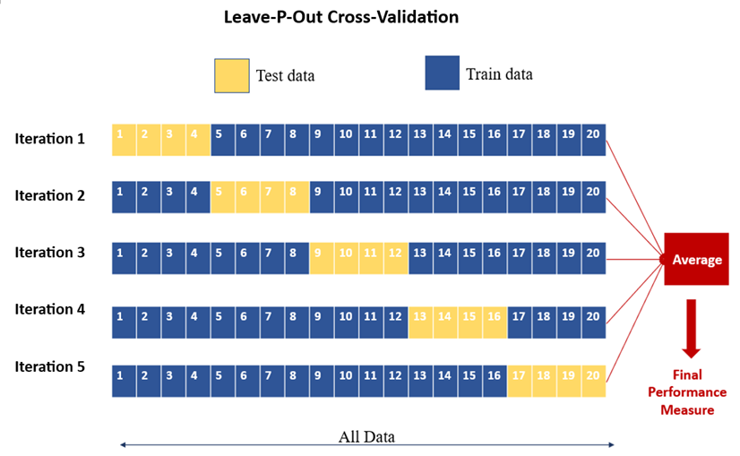
Cross Validation - Leave-P-Out (LPO)
P= 4
Not an efficient one
Multiple interactions may use the same test data.
Instead of testing one record per iteration (LOOCV), four records (since P=4) are selected each time.
USA | Singapore
©DeepSphereAI.SG 2021 | Confidential & Proprietary

Slide 17
Feature Selection
USA | Singapore
©DeepSphereAI.SG 2021 | Confidential & Proprietary

Slide 18
Feature Selection
Why or Driving Factors
Benefits
Filter Methods
Which feature correlates well
Prevent - Noise
Prevent – Overfitting
Improve Accuracy
Reduce Training Time
Avoid Bias
Redundant
Wrapper Methods
Subset of features and see which one gives best performance
Embedded Methods
Data Dimensions Criteria
USA | Singapore
©DeepSphereAI.SG 2021 | Confidential & Proprietary

Slide 19
Feature Selection
Multiple features
Thought Experiment
How many features to use it’s arts than science
Avoid useless features (Ex: Eye color)
Independent features are best
Avoid redundant features (ex: Height in Inches, and Height in centimeters, the models are both different)
Remove highly correlated features
Features should be easy to understand
Simpler relationships are easy to learn (ex: Distance between two cities vs. latitude and longitude)
Must be
Informative
Independent
Simple
USA | Singapore
©DeepSphereAI.SG 2021 | Confidential & Proprietary

Slide 20
Feature Selection
Input
Output
Algorithm Use
Pearsons’s Correlations Coefficient
Spearman’s Rank Coefficient
Numeric
Numeric
USA | Singapore
©DeepSphereAI.SG 2021 | Confidential & Proprietary

Slide 21
Feature Selection
Input
Output
Algorithm Use
ANOVA Correlations Coefficient
Kendall’s Rank Coefficient
Numeric
Categorical
USA | Singapore
©DeepSphereAI.SG 2021 | Confidential & Proprietary

Slide 22
Feature Selection
Input
Output
Algorithm Use
ANOVA Correlations Coefficient
Kendall’s Rank Coefficient
Categorical
Numeric
USA | Singapore
©DeepSphereAI.SG 2021 | Confidential & Proprietary

Slide 23
Feature Selection
Input
Output
Algorithm Use
Chi-Squared Test(Contingency Tables)
Mutual Information
Categorical
Categorical
USA | Singapore
©DeepSphereAI.SG 2021 | Confidential & Proprietary

Slide 24
How do we use multiple classifiers to solve the same problem?
Called Classifier
f(X) = Y
Output
Function
Input
Like a function, a classier takes inputs and returns results
USA | Singapore
©DeepSphereAI.SG 2021 | Confidential & Proprietary

Slide 25
How do we use multiple classifiers to solve the same problem?
Called Classifier
f(X) = Y
Features
Labels
USA | Singapore
©DeepSphereAI.SG 2021 | Confidential & Proprietary

Slide 26
How do we use multiple classifiers to solve the same problem?
X_train, X_test, y_train, y_test = train_test_split(X,y, test_size = .5)
Training Data
Training Data
Split Ration
Features
Labels
Test Data
Test Data
Among 100 records, 50 are for training and the remaining 50 are for testing
Features
Labels
USA | Singapore
©DeepSphereAI.SG 2021 | Confidential & Proprietary

Slide 27
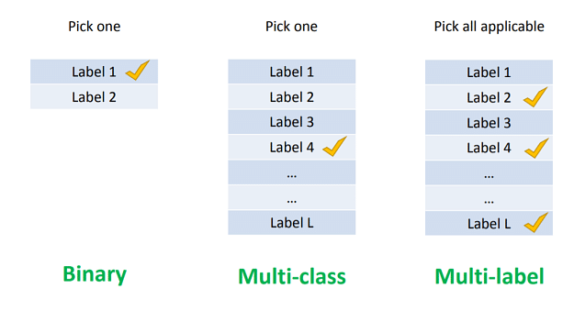
Multiclass Classification v/s Multi-Label Classification - What’s the Difference?
Multi-Class:
Multi-Label:
Each data point is assigned to only one class label.
Each data point can be set to multiple class labels.
The output is a single predicted class label for each data point.
The result is a binary vector indicating the presence or absence of each label for each data point.
Multi-Class is generally considered more straightforward, as each data point has a correct label.
Common algorithms include logistic regression, decision trees, random forests, SVMs, and neural networks.
Algorithms must be adapted to handle multiple labels, such as binary relevance, label powerset, or neural network architectures designed for multi-label scenarios.
Multi-Label: More complex due to the potential combinations of labels for each data point
USA | Singapore
©DeepSphereAI.SG 2021 | Confidential & Proprietary

Slide 28
Multiclass Classification v/s Multi-Label Classification - What’s the Difference?
Multi-Class:
Multi-Label:
Multi-Class is generally considered more straightforward, as each data point has a correct label.
Multi-Label: More complex due to the potential combinations of labels for each data point
Multi-class classification involves assigning one label to each data point, while multi-label classification involves giving multiple labels to each data point. The choice between these approaches depends on the nature of the problem and the data at hand.
USA | Singapore
©DeepSphereAI.SG 2021 | Confidential & Proprietary

